Slide 1
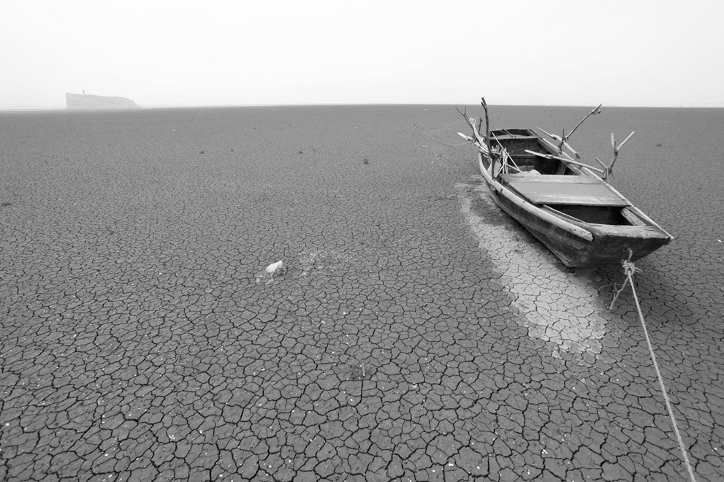


22 April 2015
This is the title of my master thesis/this presentation
Mario Rossi
Relatore: Prof. Andrea Castelletti
Controrelatore: Prof./Eng. Mario Rossi
MSc Environmental and Land Planning Engineering
School of Civil , Environmental and Land Planning Engineering
Academic year
2014-15

Slide 2
Outline
This is a simple list of the content of this presentation

Slide 3
General Topic and Research Question
This is an introduction to the topic of the thesis. The research context has to be presented, together with the main reseach question, i.e. the problem

Slide 4
PHASE I framing the work

Slide 5
State of the art REVIEW
Presentation of the state of the art literature on the topic of this thesis.
State-of-the-art literature has to be classified and described in terms of:
Methodology
Effectiveness of the different methods
Pros/cons
Research opportunities
For a good example of state of the art review see …

Slide 6
Thesis challenges and contributions
Given the state of the art presented before, and the open challenges, this thesis contributes in:
First objective/contribution
Second objective/contribution
Third objective/contribution

Slide 7
Methods and Tools
Here, the methods and tools of your thesis are described.
Flowchart/disgrams can help

Slide 8
Data and Model availability
After having described the metod, what are the data you are going to use to test/experiment your method?

Slide 9
PHASE II WORKPLAN AND EXPERIMENTS

Slide 10
WORKPLAN
Define a workflow and a set of experiments you are planning to run.
Flowchart/disgrams can help

Slide 11
PRELIMINARY Results
And here you can describe the results you got

Slide 12
PHASE III FINAL STORYLINE

Slide 13
STORYLINE
Define the storyline you would like to follow in your final thesis presentation. It should more or less follow the structure of this presentation.
When inserting FIGURES and PLOTS do not forget:
Title
Axis label and units
Caption

Slide 14
Conclusions
Conclusions.
What are the main outcome of your work?
Do they reflect the objective of your thesis?
Highlight the 2/3 most important emerging aspects and evaluate the overall outcome of the thesis

Slide 15
FURTHER DEVELOPMENT
Do not forget to mention what can be improved through new research. Those are opportunities for further development.

